Slide 1
Project quality management BAI 3020
Notes:
Check in with the students.
Introduce the lecture content – next slide.

Slide 2
The Importance of Project Quality Management
Many people joke about the poor quality of IT products.
People seem to accept systems being down occasionally or needing to reboot their PCs
But quality is very important in many technology projects

Slide 3
What Went Wrong?
In 1986, two hospital patients died after receiving fatal doses of radiation from a Therac 25 machine after a software problem caused the machine to ignore calibration data
In one of the biggest software errors in banking history, Chemical Bank mistakenly deducted about $15 million from more than 100,000 customer accounts
In August 2008, the Privacy Rights Clearinghouse stated that more than 236 million data records of U.S. residents have been exposed due to security breaches since January 2005

Slide 4
What Is Project Quality?
The International Organization for Standardization (ISO) defines:
quality as “the degree to which a set of inherent characteristics fulfills requirements” (ISO9000:2000)
Other experts define quality based on:
Conformance to requirements: the project’s processes and products meet written specifications
Fitness for use: a product can be used as it was intended

Slide 5
Project quality management
Understanding the difference between:
Process Quality – Business Process
Product Quality – End Product
Project Quality – Meeting Project Quality addresses by Project Charter
Notes:
The next step is to understand the difference between:
Process Quality is specific to the type of product, service or result being produced and the stakeholder expectations, the level of process quality will vary. Organizations strive to have efficient and effective processes.
Based on your own work experience, has your own organization continually improving on its business processes?
Product Quality is specific to the type of product, service or result being produced and the stakeholder requirements, product quality measures the extent to which the end product of the project meets the specified requirements.
Project Quality is defined within the project charter, project quality is usually expressed in terms of meeting stated schedule, cost and scope objectives. Project Quality can also be addressed in terms of meeting business objectives that have been addressed in the project charter.

Slide 6
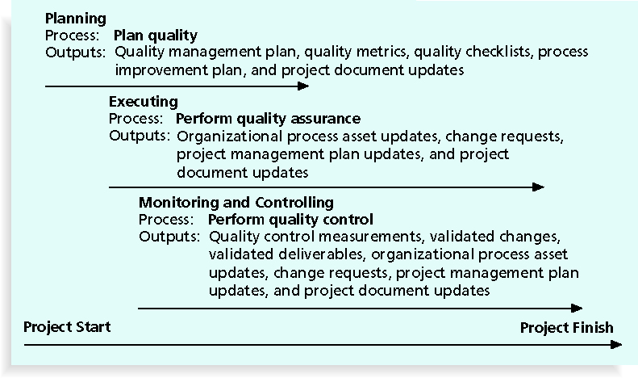
Project Quality Management Summary

Slide 7
Project quality management
Triple Constraints
Scope
Cost
Schedule
Notes:
Quality if effected by the triple constraints, project scope, schedule and cost. Quality concerns are found in all projects.

Slide 8
Project quality management
Quality Management Concepts:
Quality vs. Grade
quality – provides for stability or predictability of the product
Grade - products with the same functional use but different attributes. e.g. grading of lumbers, a lower grade of lumber can still be of high quality (no defects within its own grade).
Impact of Poor Quality – higher costs, poor quality product
Legal Implications of Quality - fraud or gross negligence, civil and criminal liabilities
Market Expectations of Quality – Stability, Social acceptance, Reliability, safely operated, warranty, maintainability
Notes:
Quality management concepts to understand in a project management environment:
Quality and Grade are not the same. Grade is a way to distinguish between products with the same functional use but different attributes. e.g. grading of lumbers, a lower grade of lumber can still be of high quality (no defects within its own grade).
Think of it this way, grade deals with the characteristics of the product whereas quality deals with the stability or predictability of the product.
Regardless of the organization the impact of poor quality can be significant; it can result in higher costs to the project and to the stakeholder, less stakeholder satisfaction, lower team morale and greater risk of project failure.
When developing a quality management plan there are legal implications to Quality that need to be addressed; criminal liability, fraud or gross negligence, civil and criminal liabilities with appropriate organization actions.
In determining what preventative measures to take to non conformance costs, the project manager must take into consideration the market expectations of the projects product or service by reviewing the stakeholder expectations of the product or service on the following criteria; : a balance of quality and cost, : the degree of conflict between product/service and the values of society, Operability: the degree to which a product/service can be /provided, the probability that the product/service will perform without failure under the given conditions for a period of time (e.g. ), : the ability of the product/service to be restored to its stated performance level within a set period of time.

Slide 9
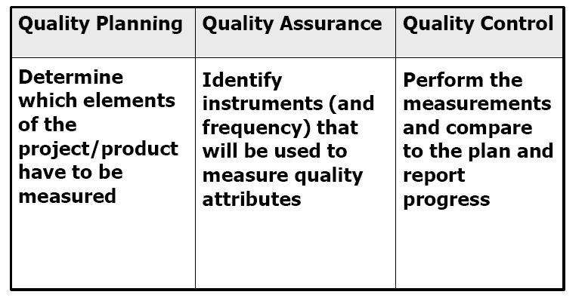
Project quality management
Notes:
Turn to page 43 of PMBOK, and identify where Quality is represented in the chart.
Quality is represented in the 3 process groups: Planning, Executing, and Monitoring and Controlling.
This chart summarizes the three quality processes: plan quality, perform quality assurance and perform quality control.
(Read the definitions of each process to what it means)

Slide 10
What Is Project Quality Management?
Project quality management ensures that the project will satisfy the needs for which it was undertaken
Processes include:
Planning quality: identifying which quality standards are relevant to the project and how to satisfy them; a metric is a standard of measurement
Performing quality assurance: periodically evaluating overall project performance to ensure the project will satisfy the relevant quality standards
Performing quality control: monitoring specific project results to ensure that they comply with the relevant quality standards

Slide 11
Project quality management Approaches
Total Quality Management (TQM)
Continuous Improvement (Kaizen)
Plan-Do-Check-Act (Demming)
Just in Time (JIT)
6 Sigma- 99.9% error-free.
Notes:
Project Quality Management generally aligns with concepts created by Deming, Juran and Crosby, as well as Total Quality Management (TQM), 6 Sigma.
TQM provides quality products/service at the right time and at the right place, which meets the stakeholder’s requirements.
Continuous improvement or Kaizen is another approach to quality and represents gradually improvements to the product/service of the project.
Plan-Do-Check-Act cycle developed by Demming is the basis for continuous improvement.
The Japanese came up with providing product/services just in time (JIT) and only when needed.
The 6 Sigma approach made popular by Motorola and other companies in the late 80’s involves setting a very high stand of 6 sigma for the products and processes that the company produces. This means that approximately of everything an organization creates or the processes it executes are

Slide 12
Project quality management
Gold Plating
Notes:
Gold Plating is the practice of providing more than what the stakeholder requested. This is not an advised approach as the project manager and team should provide only that which was approved by the stakeholder to produce or provide.
Here is an example, you go to a car dealership looking to purchase an affordable basic 4-door car, as shown in the slide. The salesperson explains that the pricing includes rust proof covering and scotch guard protection for the fabric (cost of these two items is $2,000). While you might perceive some value in these add-ons they are not what you seek in the product you want or the amount you are willing to spend on a car. These items would be referred to as gold plating.

Slide 13
Planning Quality
Implies the ability to anticipate situations and prepare actions to bring about the desired outcome
Important to prevent defects / delays by:
Selecting proper materials / technology
Training and indoctrinating people in quality
Planning a process that ensures the appropriate outcome

Slide 14
Scope Aspects of Project/products for quality analysis
Functionality is the degree to which a system performs its intended function
Features are the system’s special characteristics that appeal to users
System outputs are the screens and reports the system generates
Performance addresses how well a product or service performs the customer’s intended use
Reliability is the ability of a product or service to perform as expected under normal conditions
Maintainability addresses the ease of performing maintenance on a product

Slide 15
Performing Quality Assurance
Quality assurance includes all the activities related to satisfying the relevant quality standards for a project
Another goal of quality assurance is continuous quality improvement
Benchmarking generates ideas for quality improvements by comparing specific project practices or product characteristics to those of other projects or products within or outside the performing organization
A quality audit is a structured review of specific quality management activities that help identify lessons learned that could improve performance on current or future projects

Slide 16
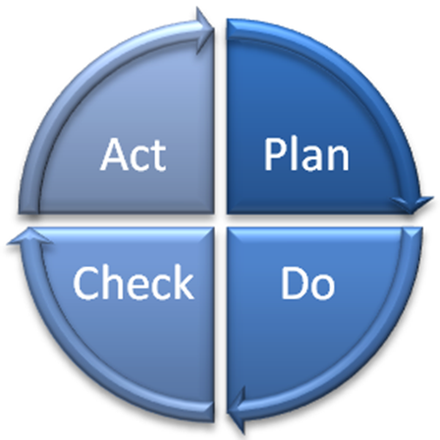
PERFORM QUALITY ASSURANCE PROCESS
Quality Theorist: W. Edwards Demming
Notes:
Demming is well knows for his 4-step cycle to improve quality: Plan, Do, Check, Act (PDCA). He developed 14 activities for implementing quality. The 14 activities are:
Use participative approach to quality
Adopt new philosophy of quality through the organization
Cease the use of mass inspections
End awards based on price
Improve production and service
Institute leadership
Eliminate numerical quotas
Emphasize education and training
Encourage craftsmanship

Slide 17
PERFORM QUALITY ASSURANCE PROCESS
Quality Theorist: Phillip Crosby
Zero Defects
& Right the First Time
Conformance
prevention
Zero defects
Price of Non-conformance
Notes:
Crosby too has 14 steps to improving quality. These steps emphasize management commitment, measurement, zero defect planning, goal setting, quality awareness and quality councils.
Crosby stresses 4 absolutes of quality as shown in this diagram:
Quality is conformance to requirements
The system of quality is prevention
The performance standard is zero defects
The measure of quality is the price of nonconformance

Slide 18
Quality Control
The main outputs of quality control are:
Acceptance
Rework
Process adjustments
There are Several Basic Tools of Quality that help in performing quality control

Slide 19
PERFORM QUALITY control PROCESS
Quality Tools
Notes:
The Quality Tools used in Quality begin as follows: (next slide)

Slide 20
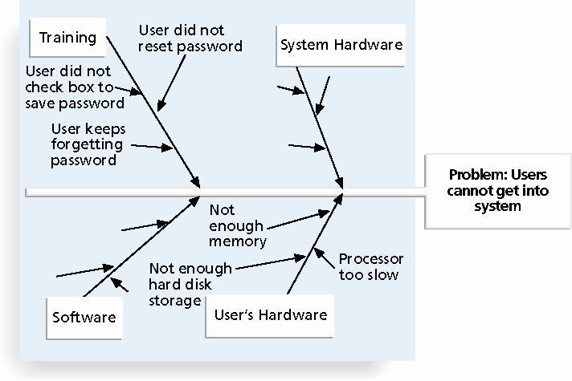
PERFORM QUALITY control PROCESS
Cause and Effect diagram
Fishbone/Ishikawa Diagram
Notes:
The fishbone (cause and effect) diagrams show how various causes and sub causes related to create problems or effects.

Slide 21
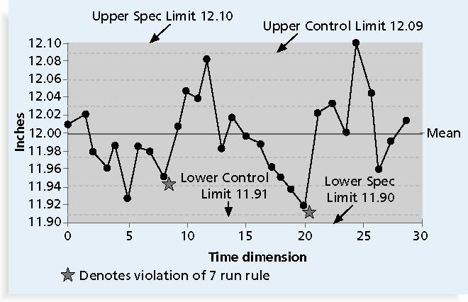
PERFORM QUALITY control PROCESS
Control Charts – 7 run rule (below, above or in sequence)
Notes:
Control charts give a graphical display of results of a process over time. Control charts include a defined upper and lower control limit, a mean and a visual pattern indicating out of control conditions, such as outliers. Points outside upper (UCL) or lower (LCL) control limites.

Slide 22
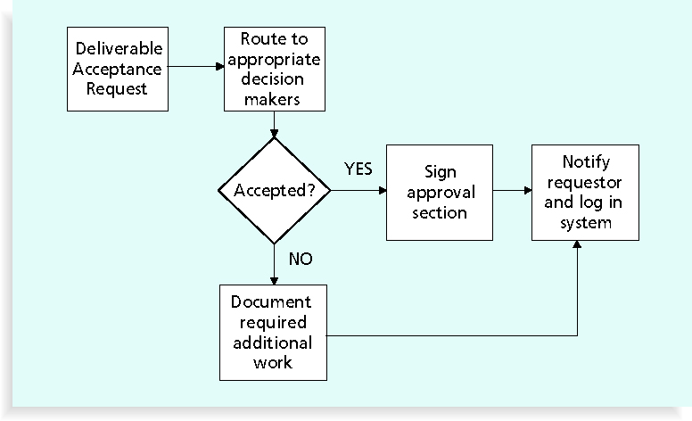
Flowcharts

Slide 23
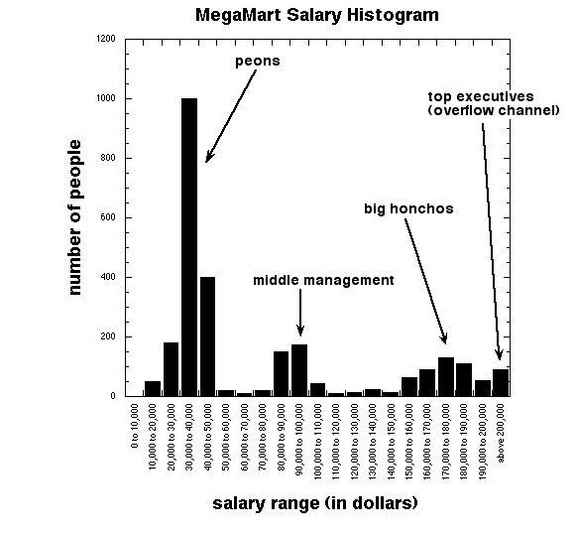
PERFORM QUALITY control PROCESS
Histograms
Notes:
Histograms or commonly called bar charts are used in statistics as a graphical display of tabulated frequencies. The categories are usually denoted in the x-axis with the height of the bar displaying the proportion of cases that fall into each category.

Slide 24
Pareto Charts
A Pareto chart is a histogram that can help you identify and prioritize problem areas
Pareto analysis is also called the 80-20 rule, meaning that 80 percent of problems are often due to 20 percent of the causes

Slide 25
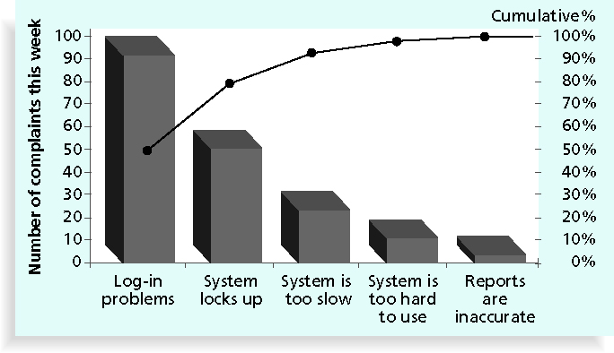
Sample Pareto Chart

Slide 26
Basic Information on Six Sigma
The target for perfection is the achievement of no more than 3.4 defects per million opportunities
The principles can apply to a wide variety of processes – particularly in mass production

Slide 27
What Went Right?
Motorola, Inc. pioneered the adoption of Six Sigma in the 1980s and saved about $14 billion
Allied Signal/Honeywell saved more than $600 million a year by reducing the costs of reworking defects and improving aircraft engine design processes

Slide 28
Six 9s of Quality
Six 9s of quality is a measure of quality control equal to 1 fault in 1 million opportunities
In the telecommunications industry, it means 99.9999 percent service availability or 30 seconds of down time a year
This level of quality has also been stated as the target goal for the number of errors in a communications circuit, system failures, or errors in lines of code
1 year @ 99% = 87 Hours

Slide 29
Testing
Many IT professionals think of testing as a stage that comes near the end of IT product development
Testing should be done during almost every phase of the IT product development life cycle

Slide 30
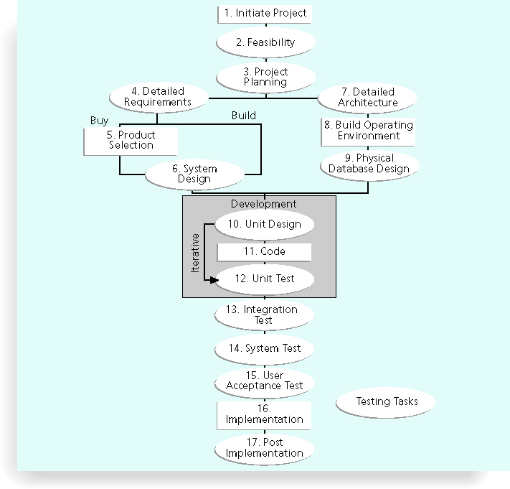
Testing Tasks in the Software Development Life Cycle

Slide 31
Types of Tests
Unit testing tests each individual component (often a program) to ensure it is as defect-free as possible
Integration testing occurs between unit and system testing to test functionally grouped components
System testing tests the entire system as one entity
User acceptance testing is an independent test performed by end users prior to accepting the delivered system

Slide 32
PERFORM QUALITY control PROCESS
Statistical Sampling
choosing part of a population for inspection
Inspections http://www.ccohs.ca/oshanswers/hsprograms/list_mft.html
Checklists
http://Quality Assurance Plan Checklist [doc])
Notes:
Statistical Sampling involves choosing part of a population for inspection for the purpose of accepting or rejecting the entire lot. The results of statistical sampling can be depicted through the use of a variety of charting methods such as histograms, scatter diagrams, or Pareto diagrams.
The advantage of using sampling techniques include less product damage, the ability to make decisions more quickly, fewer expenses and fewer sourcs. The disavantage is the possibility of bad decisions due to incomplete information.
Inspections are used after the work is completed.
Checklists may be used to assist in the measuring, examining and testing activities for quality.

Slide 33
Project quality management – Cost of Quality
Cost of Conformance and Cost of Nonconformance
Notes:
This chart provides you with a visual example of what would be considered as conformance/prevention cost items vs. nonconformance/inspection cost items.

Slide 34
Five Cost Categories Related to Quality
Prevention cost: cost of planning and executing a project so it is error-free or within an acceptable error range
Appraisal cost: cost of evaluating processes and their outputs to ensure quality
Internal failure cost: cost incurred to correct an identified defect before the customer receives the product
External failure cost: cost that relates to all errors not detected and corrected before delivery to the customer
Measurement and test equipment costs: capital cost of equipment used to perform prevention and appraisal activities

Slide 35
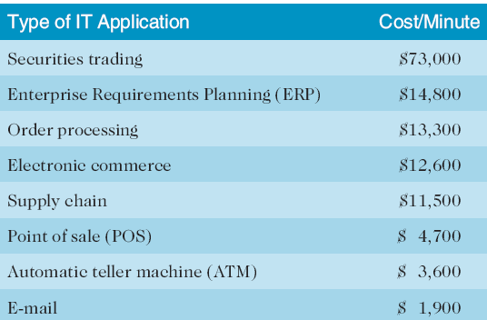
Cost of Downtime for IT Applications

Slide 36

Project quality management
Notes:
Are there any questions before we end this evening lecture by reviewing project Wow teams deliverables, on the next slide.

